Slide 1
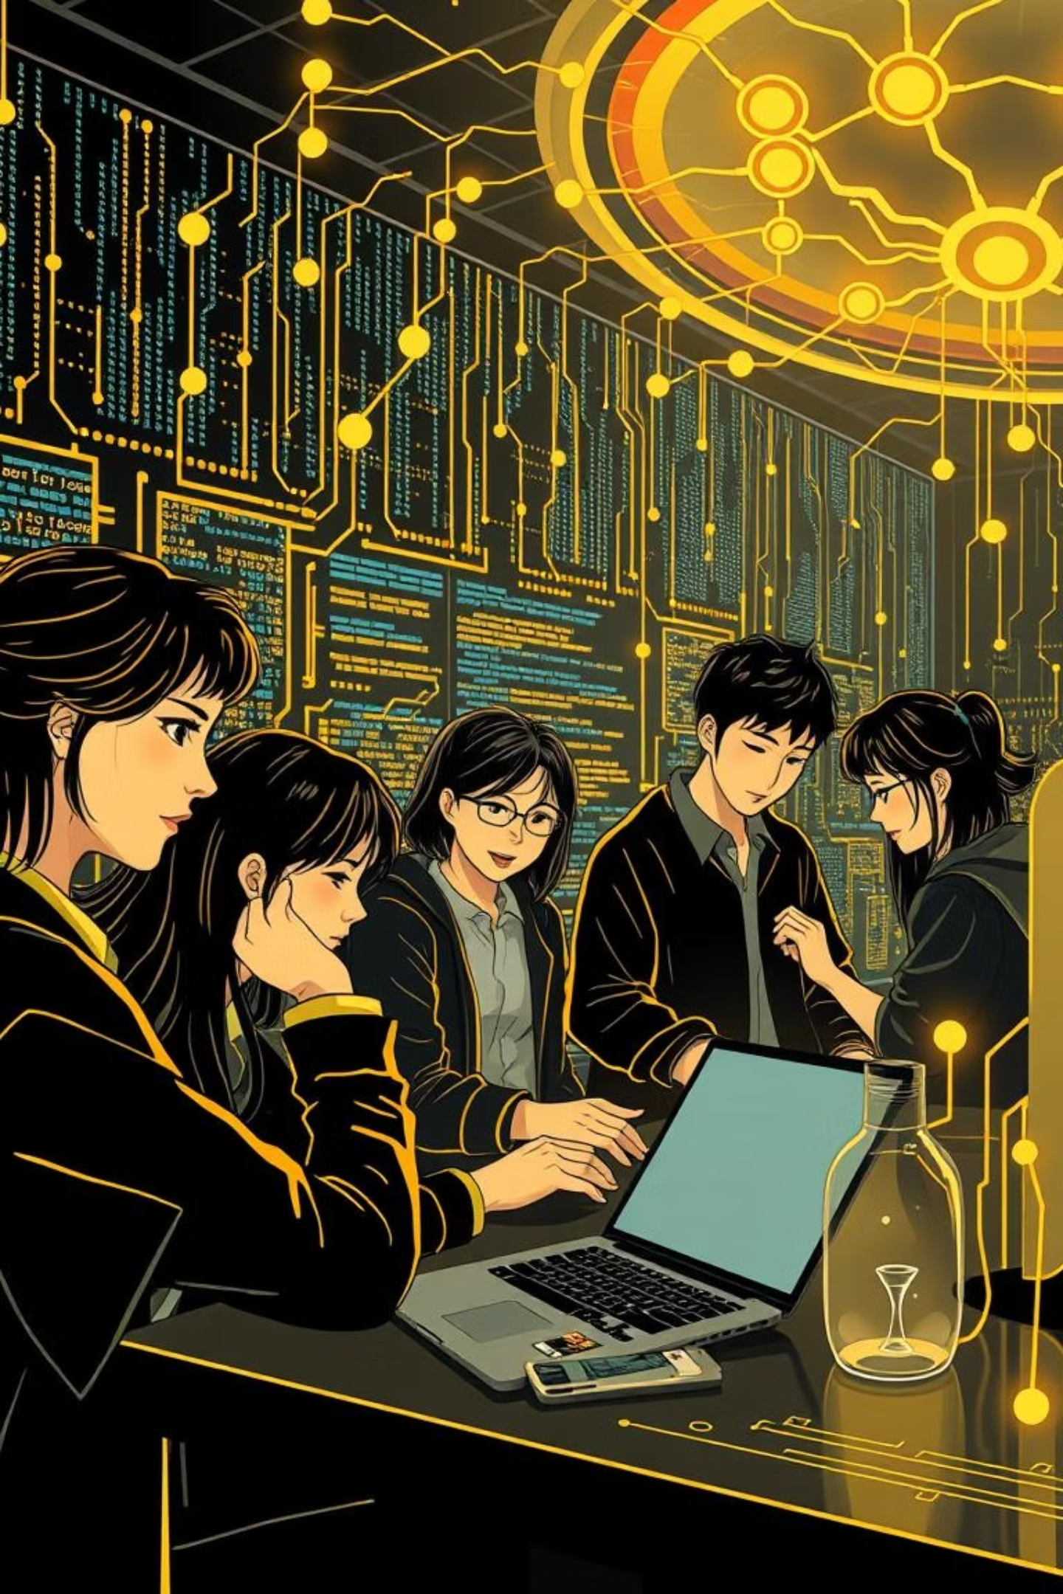
6-Month End-to-End Python Course with AI & Projects
Welcome to GaurCoder's comprehensive program designed to transform aspiring developers into AI-powered Python experts.

Slide 2
YOUR JOURNEY AHEAD
From Zero to AI Hero: Your 6-Month Roadmap
01
02
Month 1-2
Month 3
Master Python Foundations Build a rock-solid coding base.
Develop Real-World Apps Bring your code to life with GUIs and web.
03
04
Month 4-5
Month 6
Dive into AI & ML Unleash the power of intelligent systems.
Build Your AI Portfolio Showcase your skills with capstone projects.

Slide 3
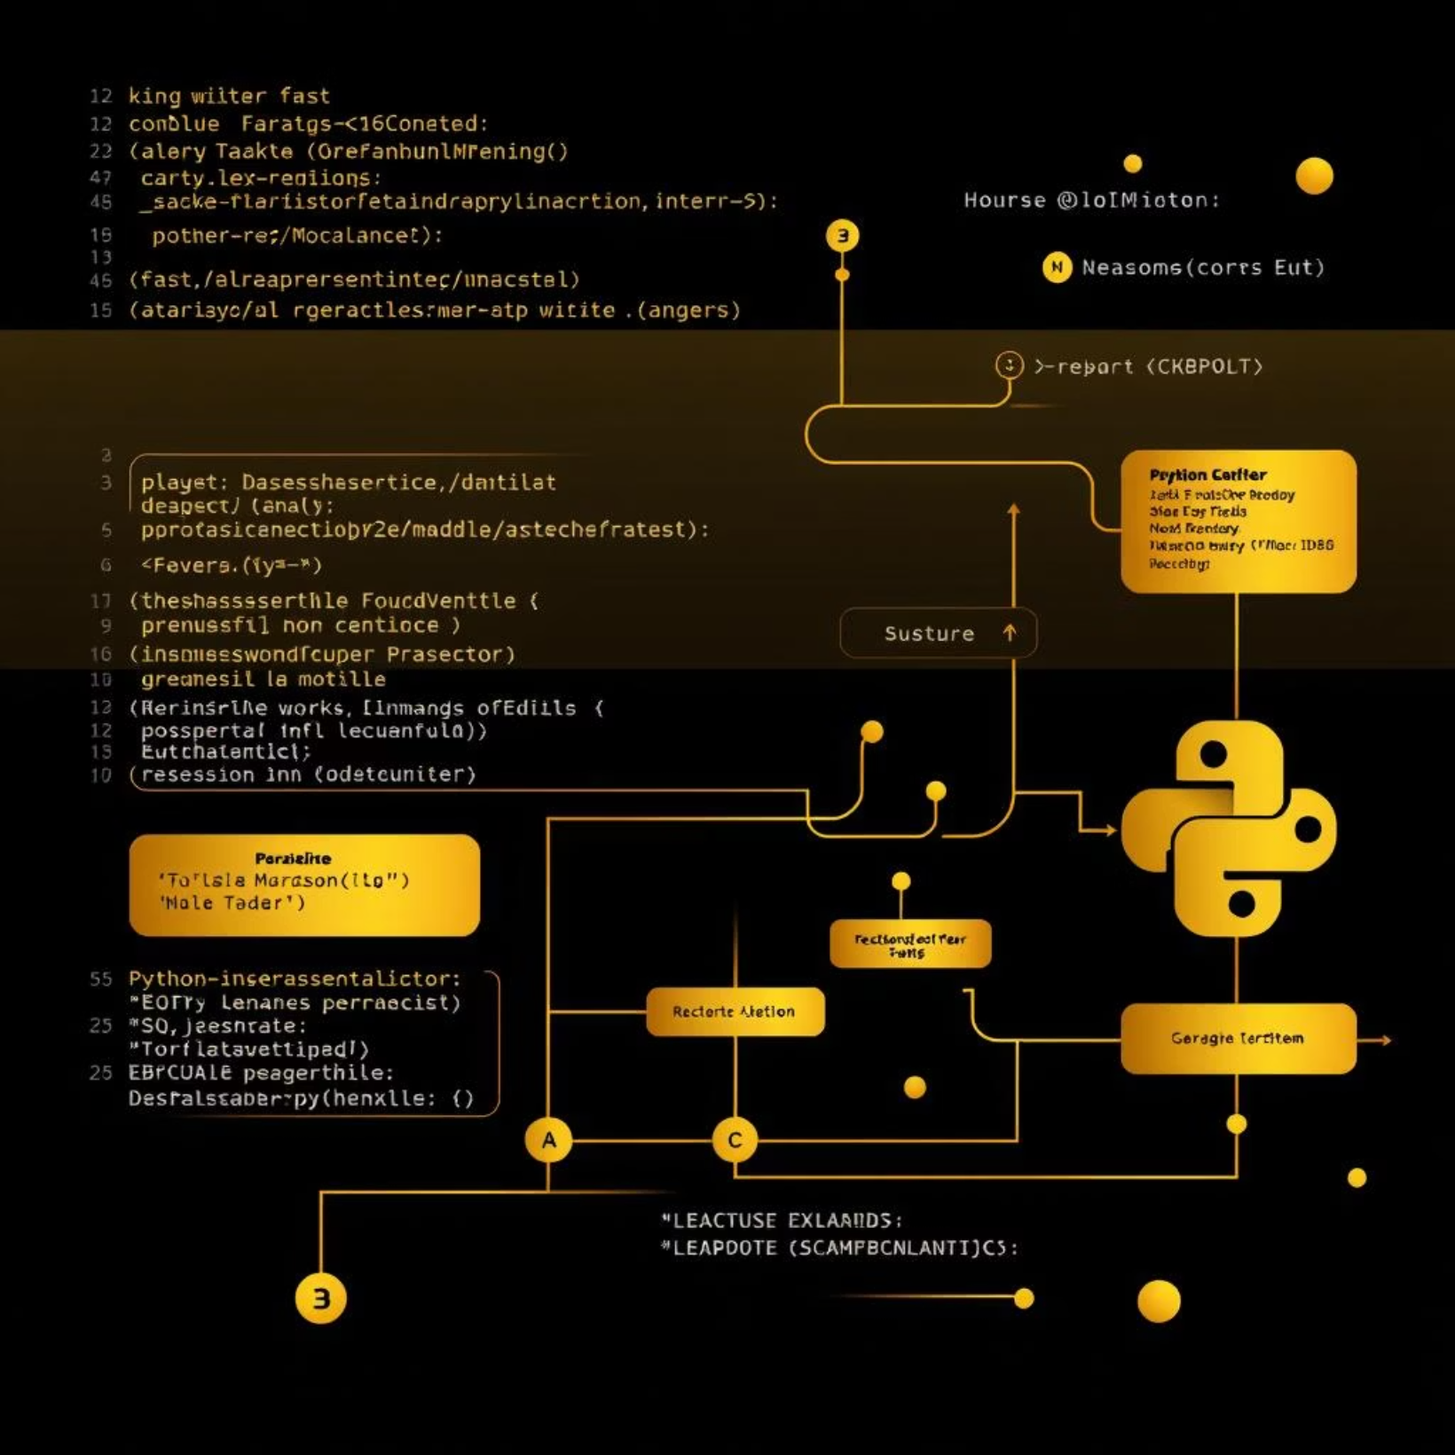
Month 1:
Python Foundations
Learning Goals: Grasp core Python syntax, control flow, and functions.
Topics Covered: Basics of Python (syntax, variables, operators, control flow), Functions & Modules.
Key Python Libraries: Standard Library.
Mini Project: Build a fully functional Calculator App or a Guess the Number Game.

Slide 4
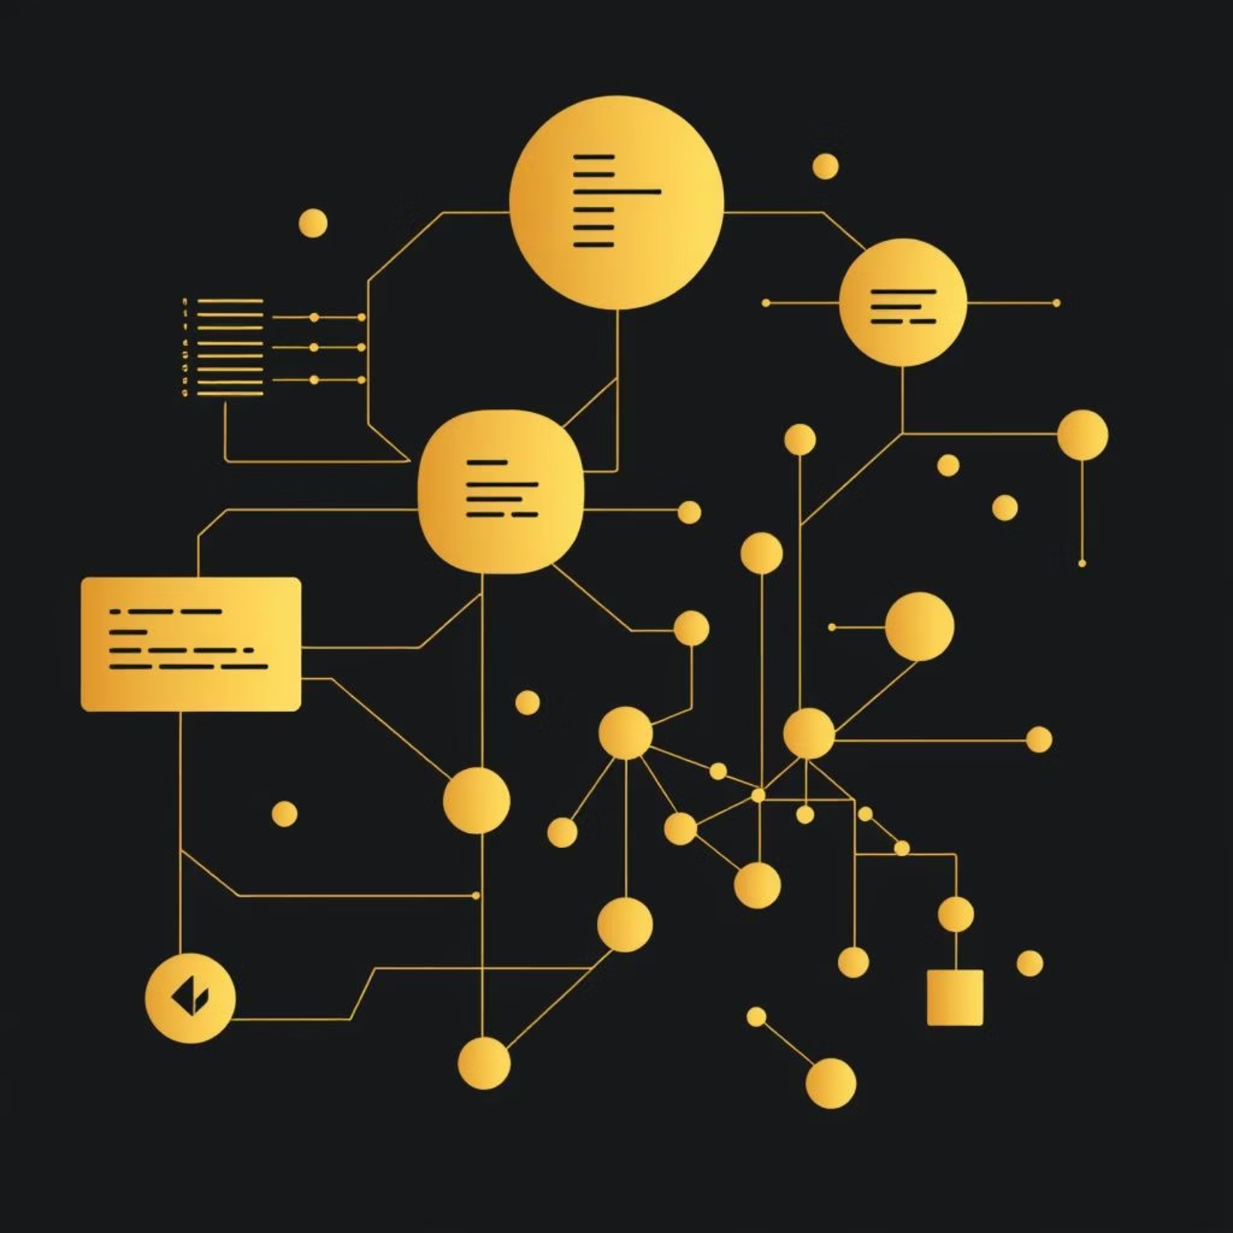
Month 2:
Data Structures & OOP
Learning Goals: Master essential data structures and object-oriented principles.
Topics Covered: Lists, Tuples, Sets, Dictionaries, String Manipulation, File Handling (JSON, CSV), Object-Oriented Programming (classes, inheritance, encapsulation).
Key Python Libraries: Collections, JSON, CSV.
Mini Project: Develop a Student Management System or a Contact Book application.

Slide 5
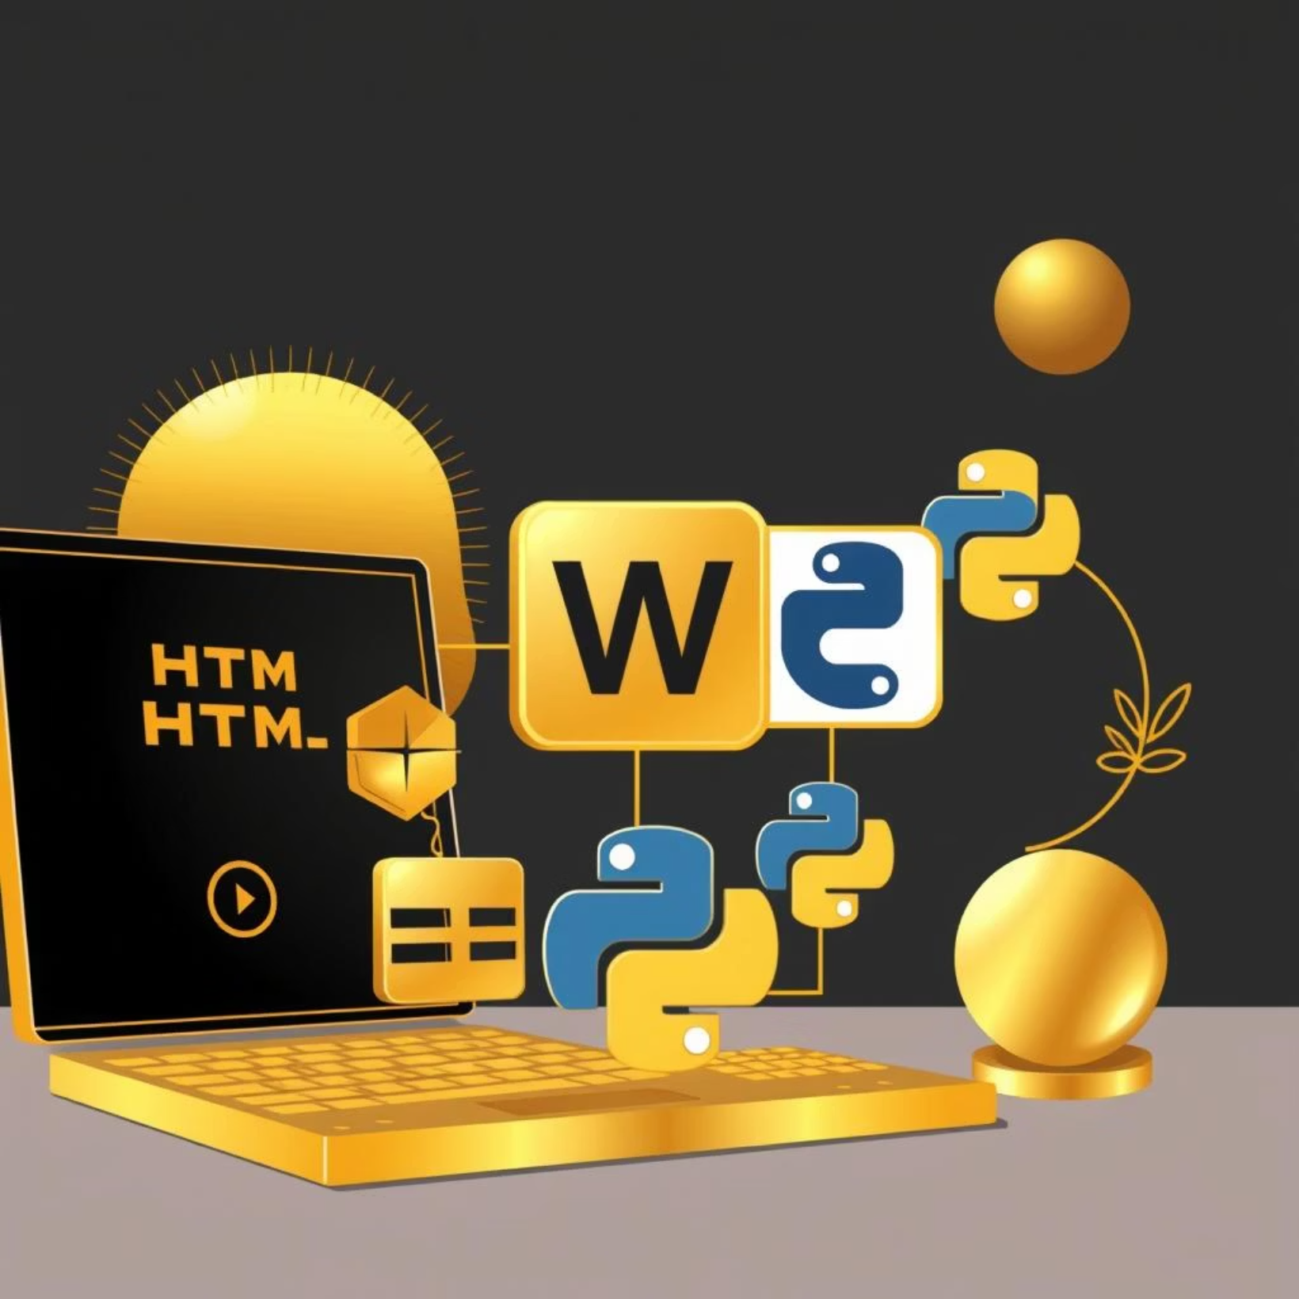
Month 3:
App Development with Python
Learning Goals: Create interactive GUI and web applications.
Topics Covered: Tkinter/PyQt (GUI apps), Flask Basics (Web apps, APIs), Database (SQLite/MySQL) integration.
Key Python Libraries: Tkinter/PyQt, Flask, SQLAlchemy.
Mini Project: Build a To-Do List App or a simple Blog Web App.

Slide 6
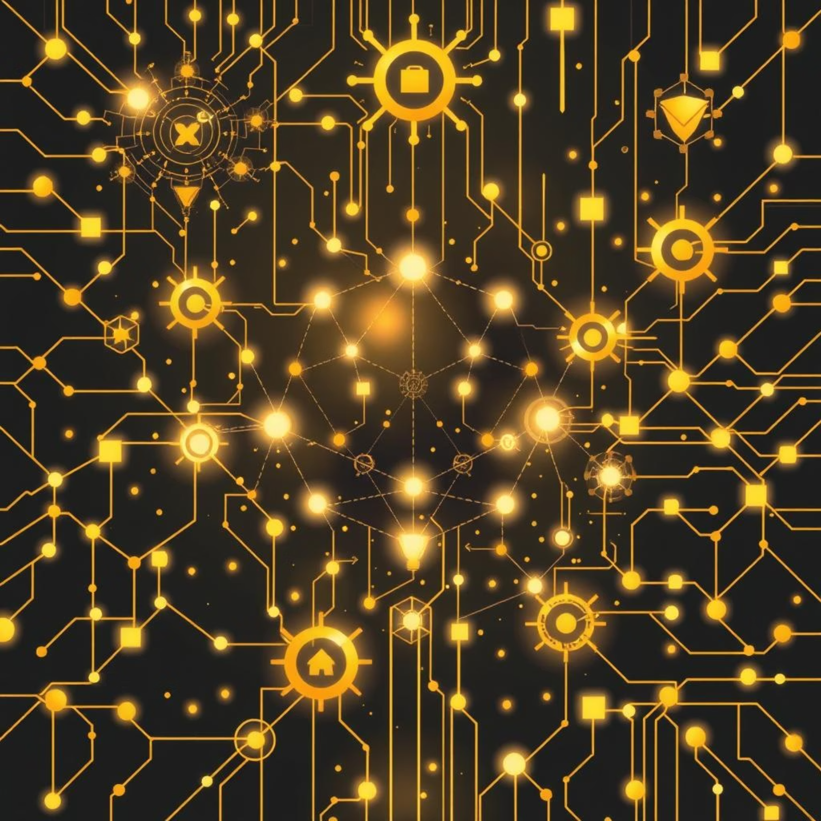
Month 4:
AI & Machine Learning Foundations
Learning Goals: Understand core ML concepts and data analysis techniques.
Topics Covered: NumPy, Pandas, Matplotlib, ML Concepts: Supervised/Unsupervised Learning, Scikit-learn basics (Regression, Classification), NLP (text preprocessing, sentiment analysis).
Key Python Libraries: NumPy, Pandas, Matplotlib, Scikit-learn, NLTK.
Mini Project: Develop a Spam Mail Classifier or a Stock Price Predictor.

Slide 7
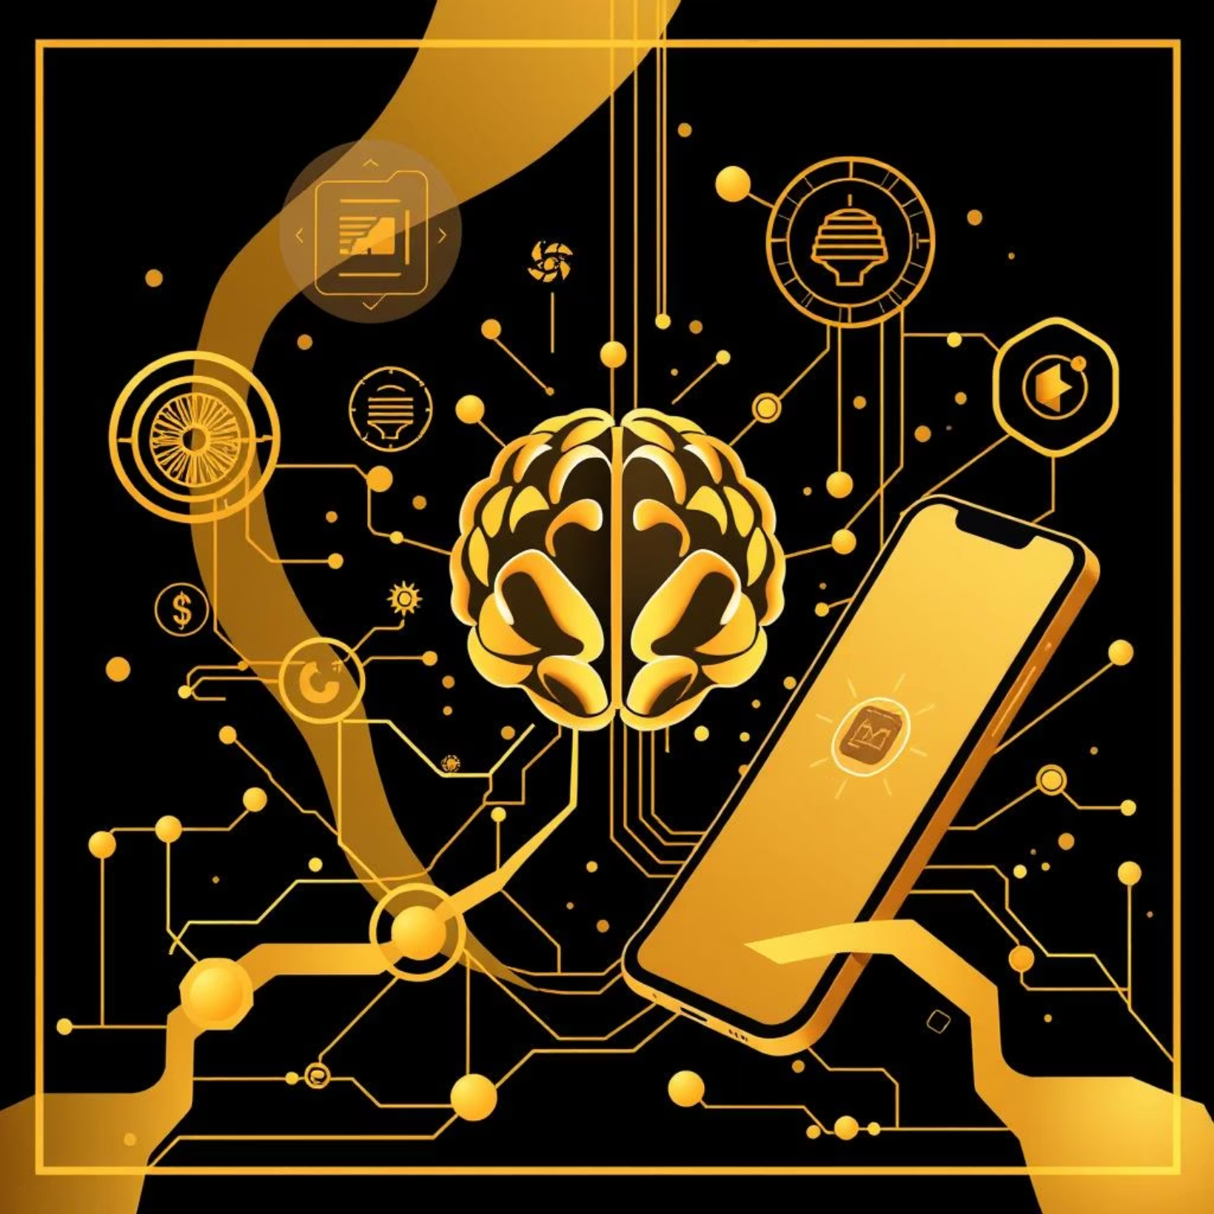
Month 5:
AI in App Development
Learning Goals: Integrate advanced AI models into practical applications.
Topics Covered: Integrating AI models in Flask/Django apps, Computer Vision with OpenCV, CNN basics (image classification), Chatbots (NLTK / Transformers).
Key Python Libraries: TensorFlow/PyTorch, OpenCV, Transformers, NLTK.
Mini Project: Create an AI-Powered Chat App or a Face Recognition Attendance system.

Slide 8
Capstone Projects & Portfolio
Your final step: building a standout portfolio that speaks volumes about your expertise.
Full-Stack AI App Development
1
Integrate front-end, back-end, and AI models to create complete, deployable solutions.
Real-World Capstone Projects
2
Choose from advanced projects like AI Recommendation Systems, Virtual AI Assistants, or Medical Image Classifiers.
Showcase Your Work
3
Learn to package projects, host on GitHub, and optimize your resume and LinkedIn for tech roles.

Slide 9


What Makes GaurCoder Different?
End-to-End Curriculum
Project-Centric Learning
From basic Python to advanced AI integration, all in one place.
Hands-on projects in every module to build practical skills and a robust portfolio.
Career-Ready Skills
Portfolio & Showcase
Develop sought-after AI and machine learning expertise for immediate job readiness.
Guidance on building a professional portfolio for recruiters.

Slide 10

Your Future Starts Here
Upon completion, you'll possess:
Mastery of Python (from basics to advanced AI).
A ready-to-showcase portfolio for jobs, freelancing, or higher studies.
5 Mini Projects + 3 Capstone Projects showcasing diverse AI applications.
The confidence to build any AI-powered application.

